Slide 1

LASCON X
Resources for Neuronal Modelling
Volker Steuber
Biocomputation Research Group
University of Hertfordshire
Arnd Roth
Neural Computation Lab
University College London

Slide 2
Types of resources for neuronal modelling
Simulators
Conductance-based multi-compartmental models
Abstract neuronal models, large scale simulations
Reaction-diffusion modelling, simulations of intracellular processes
General purpose software, custom-built simulations
Databases
Tools for the generation and analysis of neuronal morphologies
Interoperability frameworks
Other sources of information

Slide 3
Types of resources for neuronal modelling
Simulators
Conductance-based multi-compartmental models
Abstract neuronal models, large scale simulations
Reaction-diffusion modelling, simulations of intracellular processes
General purpose software, custom-built simulations
Databases
Tools for the generation and analysis of neuronal morphologies
Interoperability frameworks
Other sources of information

Slide 4
Simulators for conductance-based models
NEURON
https://www.neuron.yale.edu/neuron/
https://nrn.readthedocs.io/
Model specification: hoc and Python
Powerful GUI allows simulations with intermediate degree of complexity
without scripting (CellBuilder, ChannelBuilder)
Tools for optimisation (MultiRunFitter) and analysis (ModelView)
rxd reaction-diffusion modelling
Compiled language (NMODL) provides flexibility to add new elements
such as ion channels, ion concentrations, plastic synapses, artificial cells, …
Event-driven system for simulation of simple spiking neurons
Support for parallel simulations, GPU support
Large user community (> 1600 forum and mailing list subscribers)
Courses: 5-day summer course, 1-day presentation at SfN meeting
The NEURON Book, Carnevale & Hines, Cambridge University Press, 2006
Network modelling in NEURON is facilitated by NetPyNE https://netpyne.org/

Slide 5
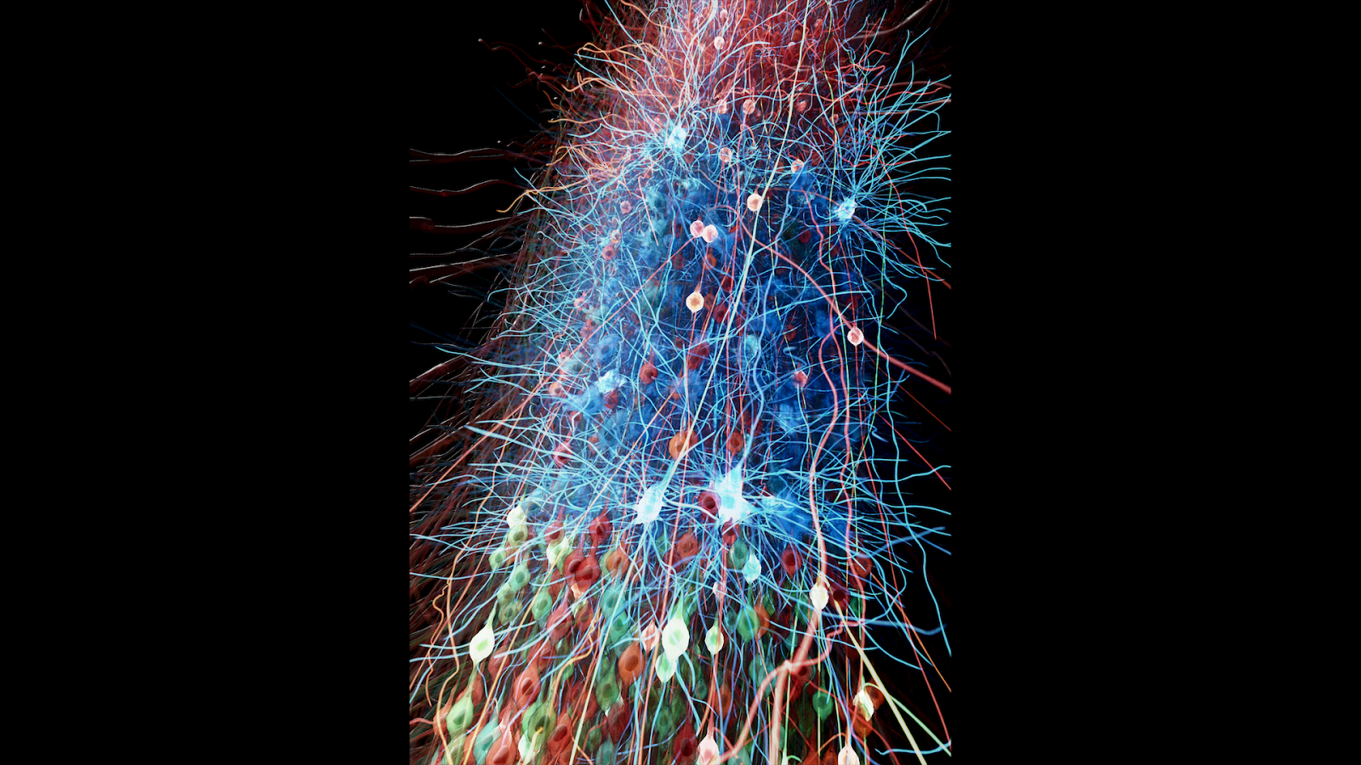
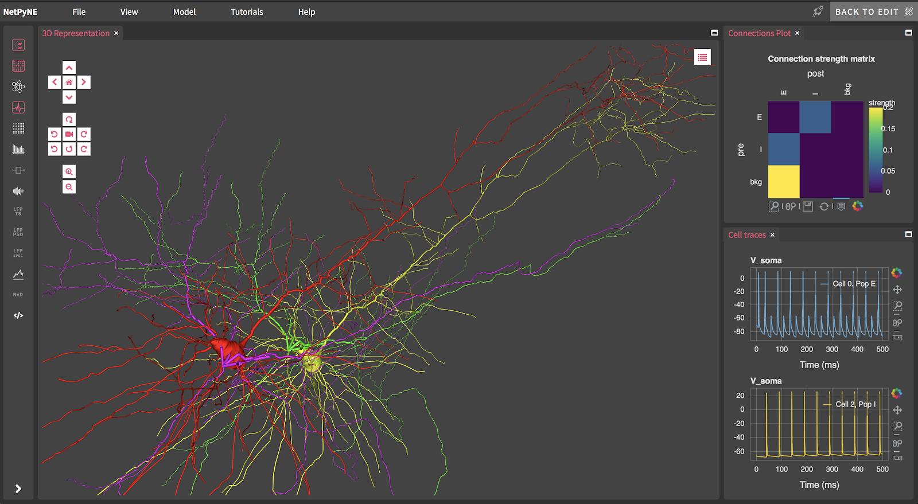
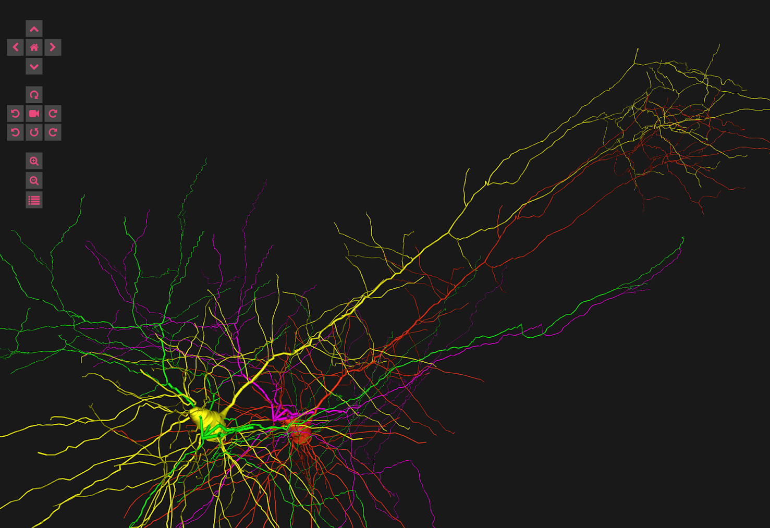
Simulators for conductance-based models
NetPyNE
https://netpyne.org/
NetPyNE (Networks using Python and NEURON) is a Python package to facilitate simulation of biological neuronal networks using the NEURON:
create declarative description of the model
run parallel simulations using NEURON
analyze and visualize results
run parameter optimization

Slide 6
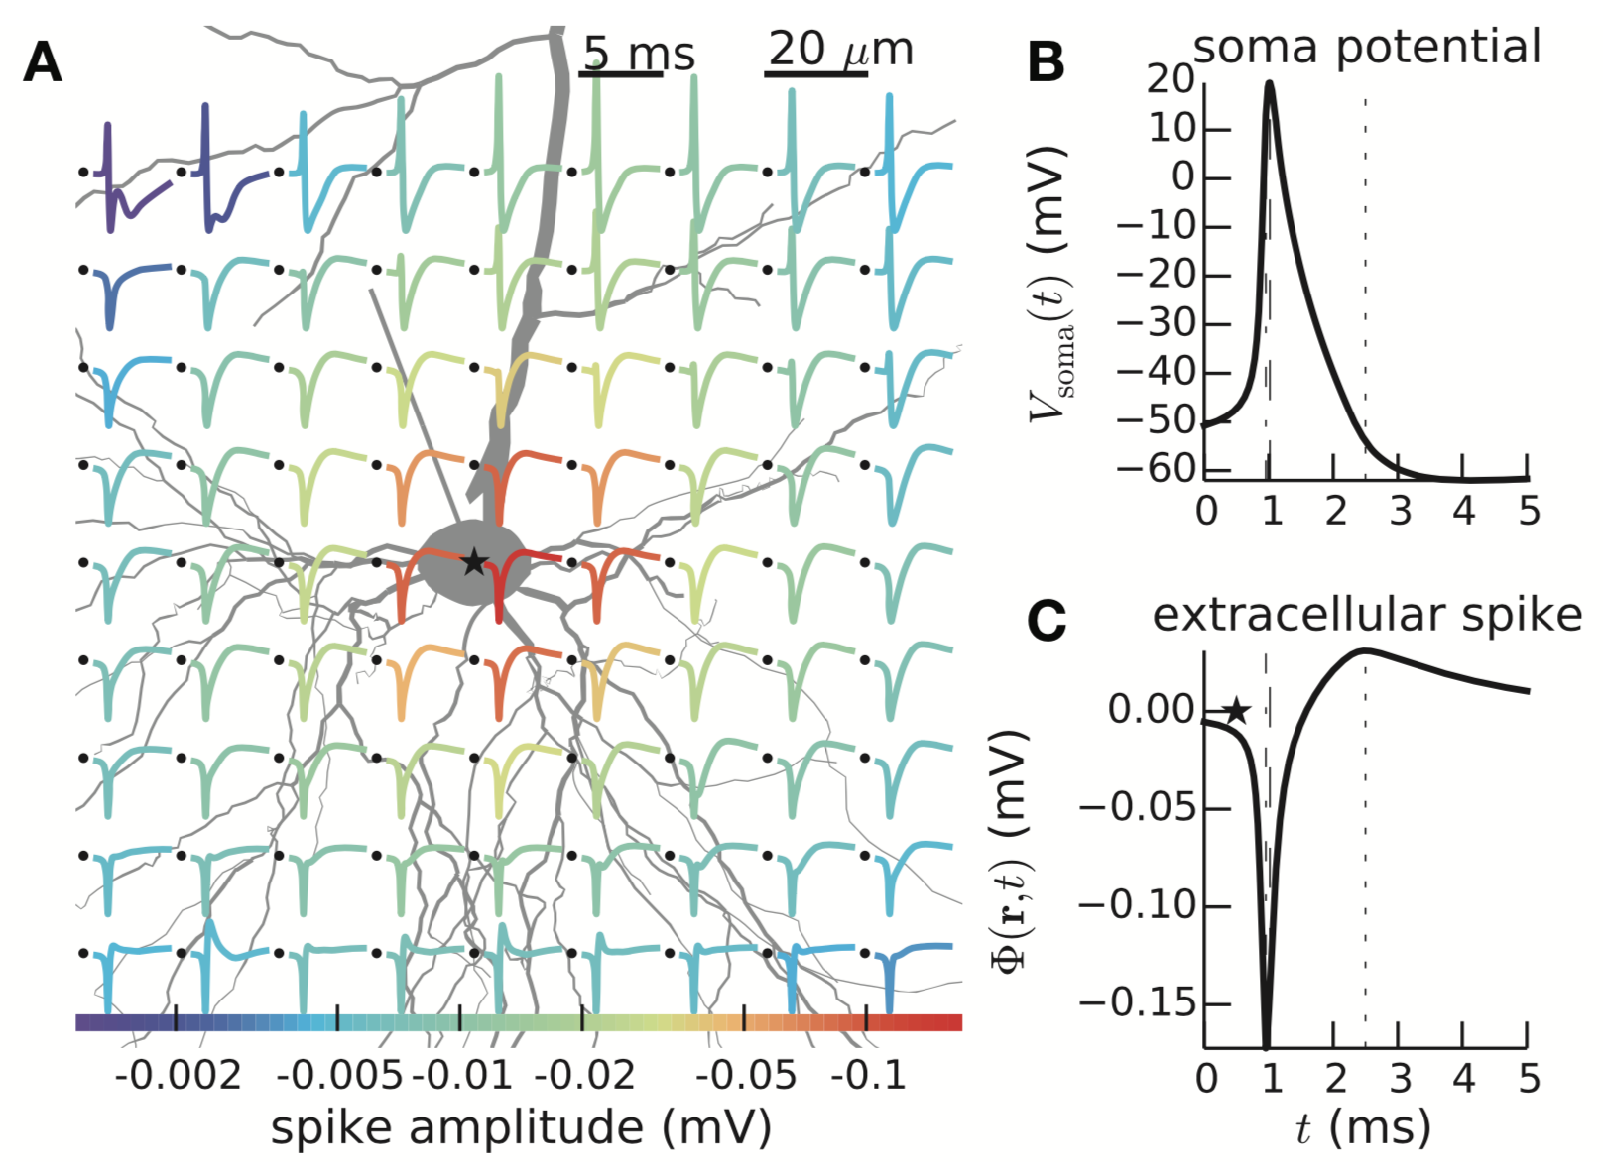
Simulators for conductance-based models
LFPy
https://lfpy.readthedocs.io/
A tool for biophysical simulation of extracellular potentials generated
by detailed model neurons
Python-based and built on top of NEURON
LFPy 2.x computes extracellular spikes, LFP, ECoG, EEG and MEG

Slide 7
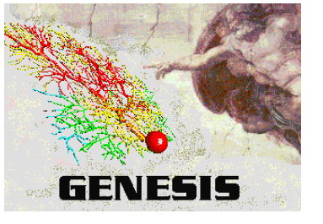
Simulators for conductance-based models
GENESIS 2
http://genesis-sim.org
Model specification in GENESIS .g code
Object-oriented design facilitates exchange
and reuse of model components
Simulations can be constructed quickly from
> 125 precompiled object types
Extensive documentation online and a book,
which also provides a general introduction to computational neuroscience
(The Book of GENESIS, Bower & Beeman, Springer, 1997)
Intuitive and flexible way of constructing large-scale network simulations
Specialised libraries for simulating biochemical reactions
(kinetikit and Chemesis)

Slide 8
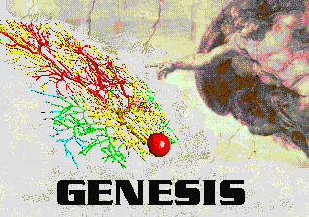
Simulators for conductance-based models
History of GENESIS
1985
Piriform Cortex Model
Requirements
Design
1988
Genesis 1.0
Purkinje cell model
1998
Piriform Cortex Model v2
Genesis 2.0
pyGenesis
Cerebellar Cortex Model
2000
PGenesis (PVM)
NeuroML
PGenesis (MPI)
2002
NineML
2018
Genesis 3.0
Moose
SBML
(Neurospaces, CBI Architecture)

Slide 9
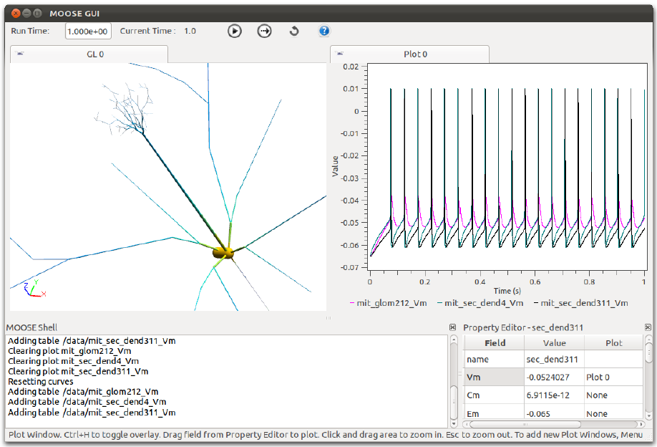
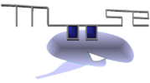
Simulators for conductance-based models
MOOSE
https://moose.ncbs.res.in/
Multi-Scale Object Oriented Simulation Environment
Reimplementation of GENESIS 2 core, compatible with GENESIS 2 scripts
Imports NeuroML, SBML, swc files directly
Python scriptable interface to integrate chemical and electrical models
3D visualiser for neural activity
GUI for running chemical models

Slide 10
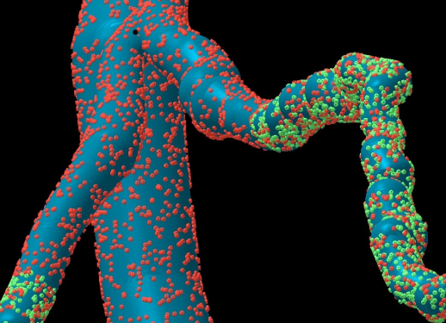
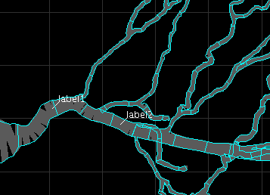
Simulators for conductance-based models
PSICS
http://www.psics.org
For efficient simulations of neurons with stochastic ion channel models
Designed to explore the effect of stochasticity and morphology on behaviour
Declarative model specification in XML-based format
Cannon et al. PLOS Comp Biol 2010: probabilistic dendritic spikes
Exact channel positions Shape-preserving discretisation

Slide 11
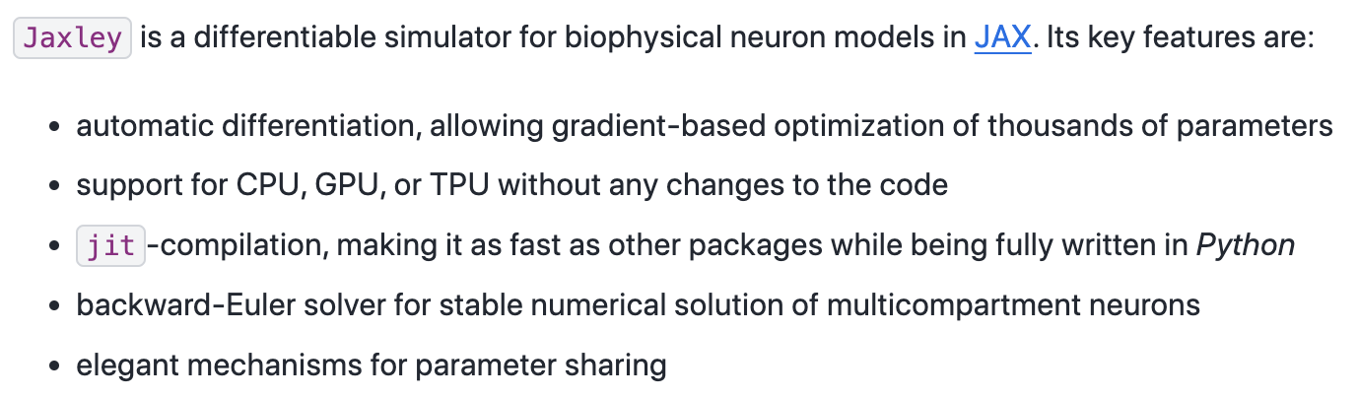
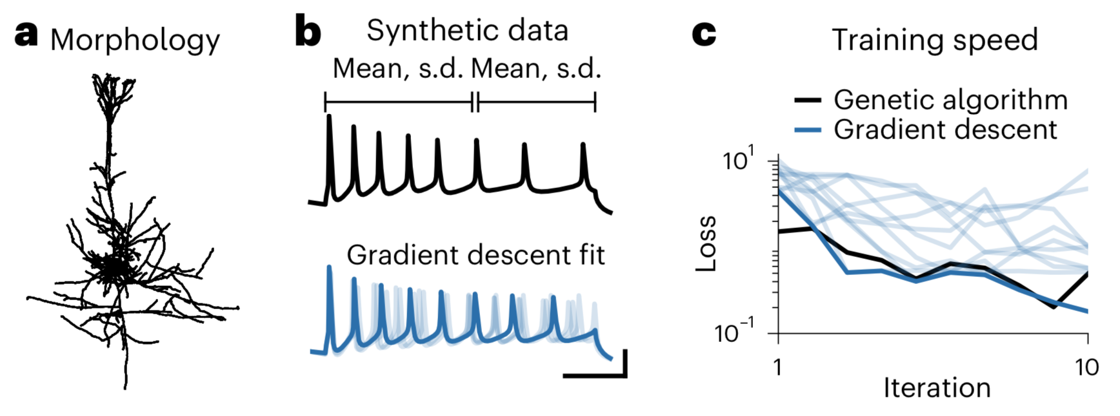
Simulators for conductance-based models
JAXLEY
https://jaxley.readthedocs.io/

Slide 12
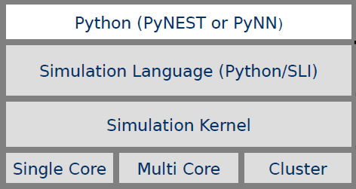
Simulators for abstract neuronal models
NEST
https://www.nest-simulator.org/
Designed for large neural
networks (100,000 neurons,
millions of connections)
Simulations run on multi-
processors or clusters
Network models are built from
neurons, synapses and devices and
described in a high-level simulation
language
Models of neurons, synapses and
devices are written in C/C++
> 50 types of neuronal models
(I&F, AdEx, Izhikevich, HH, …) and
> 10 synapse models (STDP, STD, …)
Recent release supports gap junctions, structural plasticity, K computer
Current projects include NESTML, NESTIO data recording
Current
Synapse 1
Neuron 1
Spike
Neuron 2
Spike

Slide 13
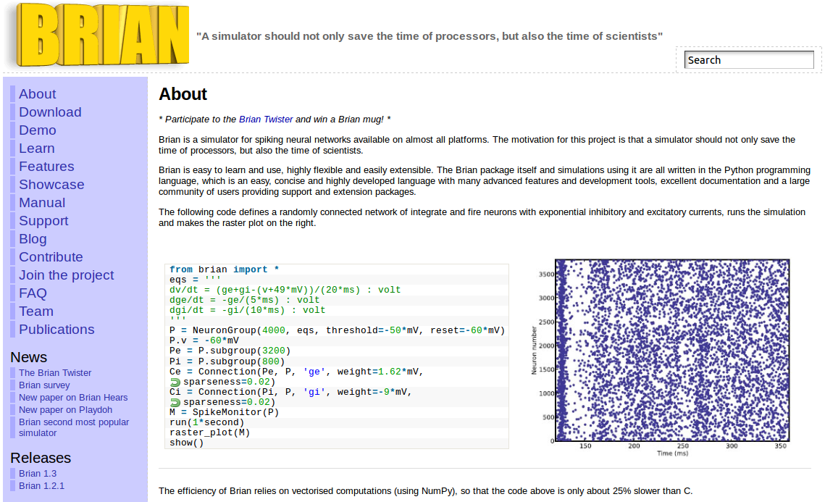
Simulators for abstract neuronal models
Brian 2
http://www.briansimulator.org
Two versions: Brian 1 (maintenance release) and Brian 2 (recommended for new users)

Slide 14
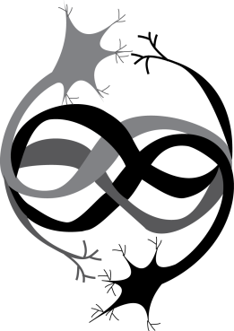
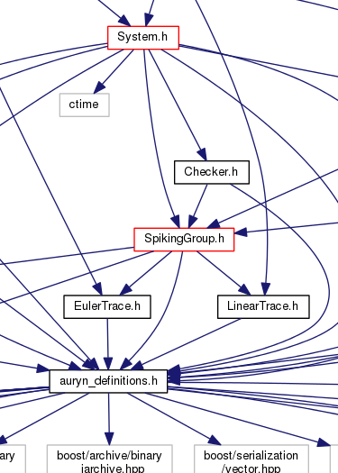
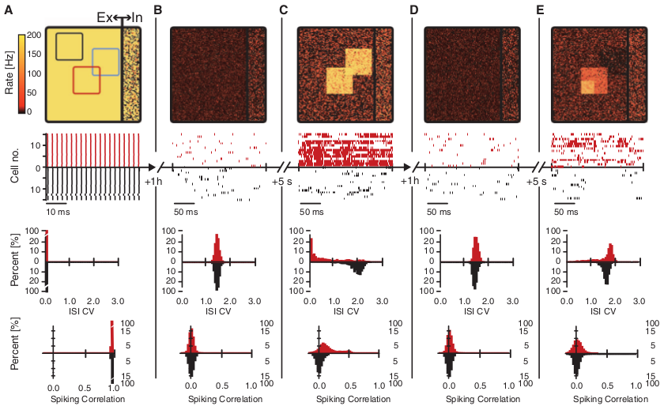
Simulators for abstract neuronal models
Auryn
https://fzenke.net/auryn
High-speed simulator (faster than real time
for medium size network models)
Developed specifically for large time scale
simulations with synaptic plasticity such as
those in Vogels et al. (2011)
Based on LIF models, can be extended by adding C++ code

Slide 15
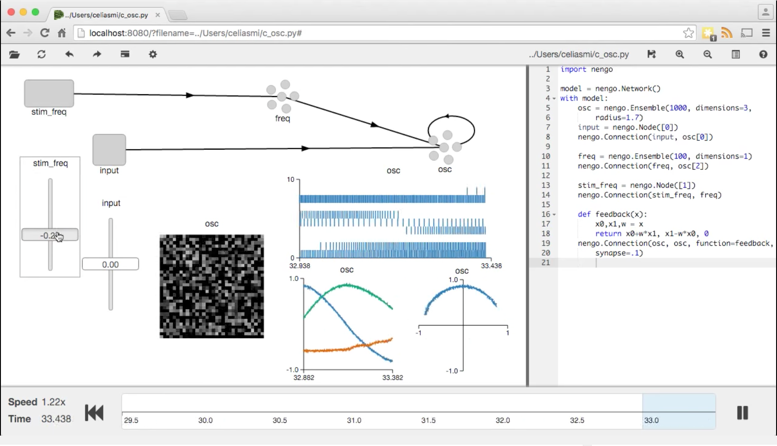
Simulators for abstract neuronal models
Nengo 2.0
https://www.nengo.ai/
Graphical and scripting simulator for large scale spiking and non-spiking neural systems
Support CPUs, GPUs, MPI and neuromorphic chips
Can combine deep learning with spiking networks
> 40 Jupyter notebooks covering core Nengo usage

Slide 16
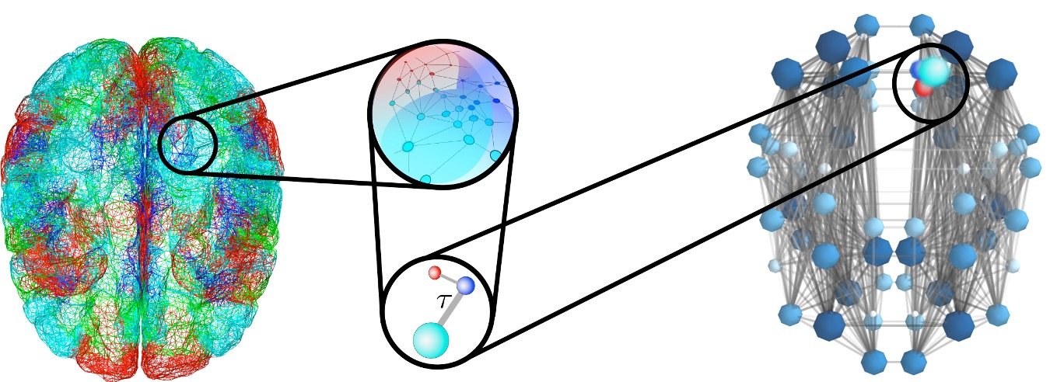

Simulators for abstract neuronal models
The Virtual Brain
https://www.thevirtualbrain.org
Platform for full brain network simulations using biologically realistic connectivity
Simulate macroscopic signals including fMRI, EEG and MEG
Thousands of registered users
6400
Network node:
Mean field modeling
Connectome:
connectivity & time delays

Slide 17

Simulators for abstract neuronal models
GeNN
https://genn-team.github.io/
Toolbox of C/C++ libraries for neural network
simulations on GPU hardware
User defines a network using a C-function interface, e.g.
model.addNeuronPopulation(“PN”, _NAL, POISSONNEURON, myPOI_p, myPOI_ini);
model.addSynapsePopulation(“PNKC”, NSYNAPSE, DENSE, INDIVIDUAL_G, “PN”, “KC”,
myPNKC_p);
Predefned neuron models include HH, I&F, Rulkov maps
Can implement learning in spiking neural networks using different versions
of backpropagation through time (BPTT)
GeNN generates code to run on the GPU and code for communication
between GPU and CPU
User writes own simulator code otherwise
Facility to include user-defined neuron models
Plans to implement PyNN interface

Slide 18
Simulators for abstract neuronal models
Other simulators
Topographica: grid based simulations of brain areas, support for topographic fields
https://ioam.github.io/topographica/
MIIND: population level simulator for cognitive modelling
https://miind.sourceforge.net/
NEMO: simulator for networks of Izhikevich neurons on GPUs
https://nemosim.sourceforge.net
Gepetto: web based simulator and visualisation tool
http://www.geppetto.org
Neuromorphic systems: SpiNNaker, BrainScaleS (faster than real time)

Slide 19
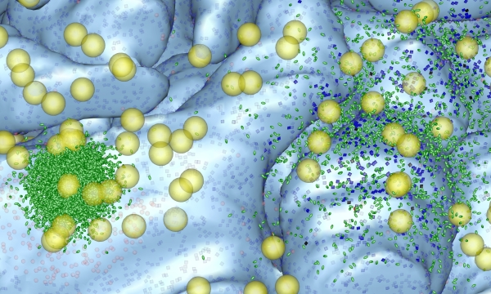
Simulators for reaction-diffusion modelling
MCell
https://mcell.org/
Monte Carlo simulator of cellular microphysiology
Models spatially realistic 3D reaction-diffusion systems
Tracks diffusion and reaction of individual particles in 3D volumes
and on 2D surfaces embedded in 3D using Brownian dynamics
High-level, flexible model description language and analysis capabilities
Powerful visualisation using CellBlender

Slide 20

Simulators for reaction-diffusion modelling
STEPS
https://steps.sourceforge.net
STochastic Engine for Pathway Simulation
Supports well-stirred and spatial stochastic simulations
Tetrahedral mesh allows for accurate complex boundary representation
Solvers are validated against 11 reaction-diffusion systems with known
analytical solutions
STEPS > 3.0 provides parallel solutions for stochastic spatial reaction-diffusion
and electric field simulation

Slide 21
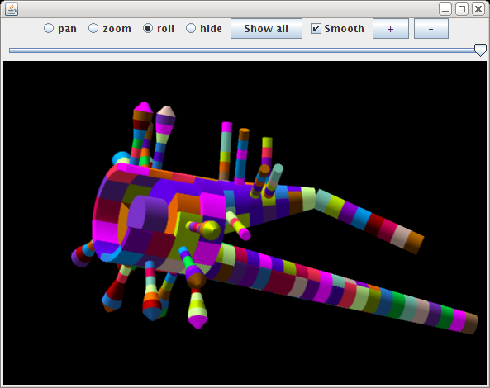
Simulators for reaction-diffusion modelling
NeuroRD
https://krasnow1.gmu.edu/CENlab/software.html
Efficient stochastic reaction-diffusion simulator
Java program that runs on any platform
XML-based model specification

Slide 22
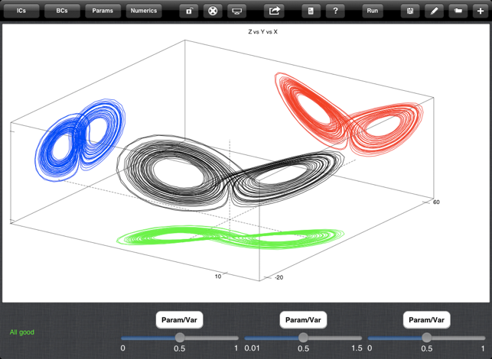
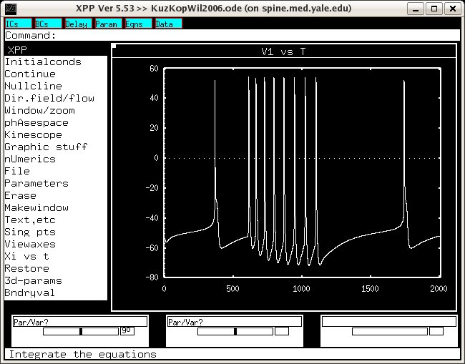
General purpose software
XPP: software package for the analysis and simulation of dynamical systems
https://sites.pitt.edu/~phase/bard/bardware/xpp/xpp.html
(also available with MATLAB interface and as app for Android and iPhone)
MATLAB
Python
C++
Java

Slide 23
Mauricio’s list
Dynamical system software
XPPAUT (binary):
https://sites.pitt.edu/~phase/bard/bardware/xpp/xpp.html
MATCONT (MATLAB): https://sourceforge.net/projects/matcont/
PyDSTool (python 2.7 and 3): https://pypi.org/project/PyDSTool/
Brain Dynamics Toolbox (MATLAB): https://bdtoolbox.org/
Notes:
Dividi a apresentação em 3 etapas:
1) uma breve motivação/introdução
2) uma descrição físico-química dos fenômenos microscópicos (na escala de células e membranas)
3) uma tentativa bem simplificada de juntar as outras duas partes e relacionar moléculas com atividade microscópica com comportamentos...
Já adianto que eu tô aprendendo essas coisas junto com vocês,
então podem me interromper a qualquer momento pra fazer comentários ou perguntas

Slide 24
Types of resources for neuronal modelling
Simulators
Conductance-based multi-compartmental models
Abstract neuronal models, large scale simulations
Reaction-diffusion modelling, simulations of intracellular processes
General purpose software, custom-built simulations
Databases
Tools for the generation and analysis of neuronal morphologies
Interoperability frameworks
Other sources of information

Slide 25
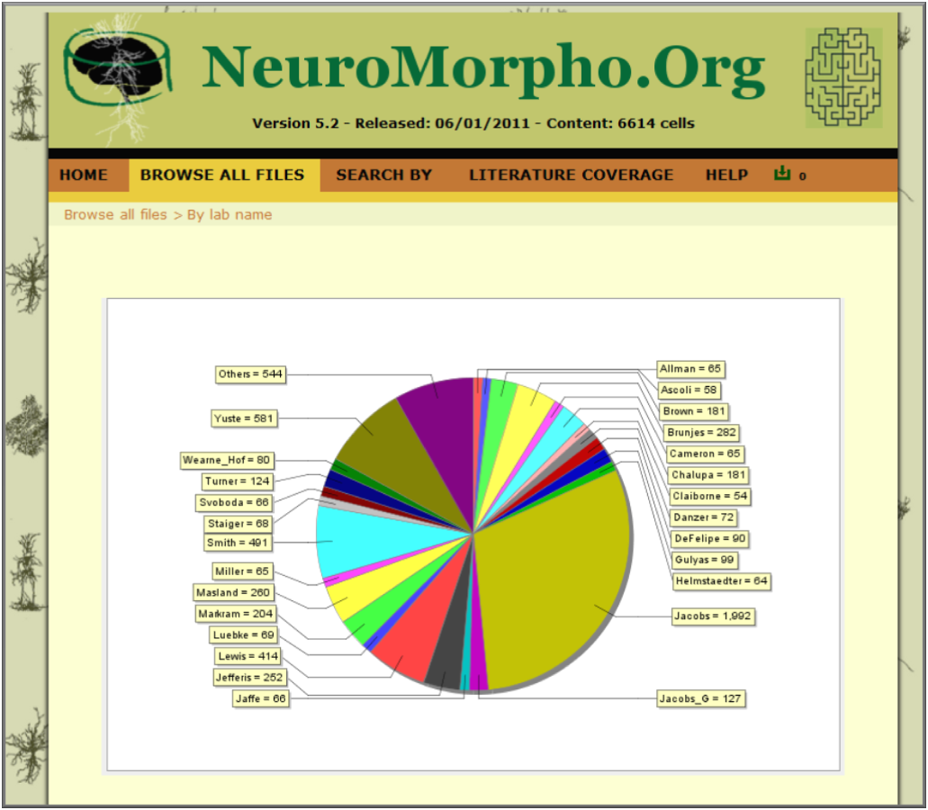
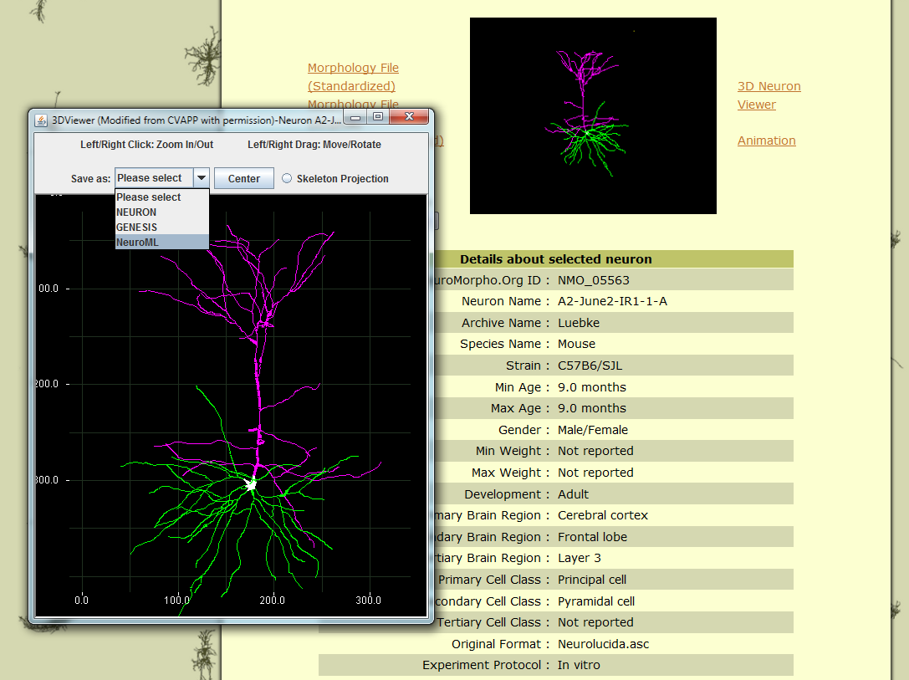
Databases
NeuroMorpho
https://neuromorpho.org
Repository of > 280,000 reconstructed neurons from diverse brain regions
and species (.swc format)

Slide 26
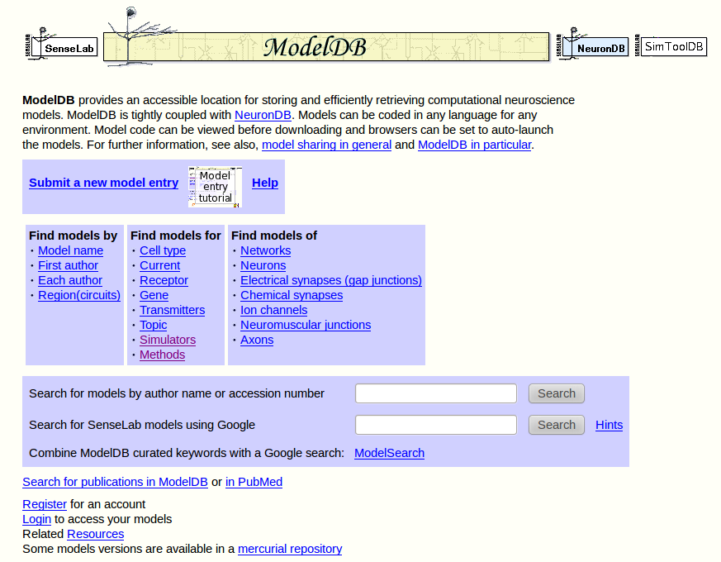
Databases
ModelDB
https://modeldb.science

Slide 27
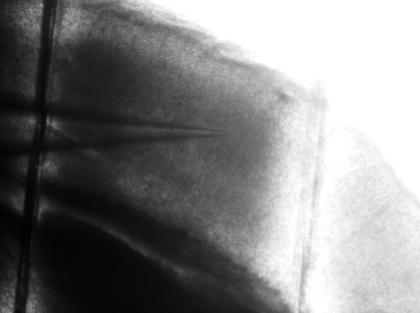

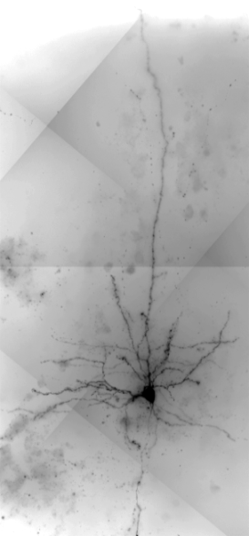
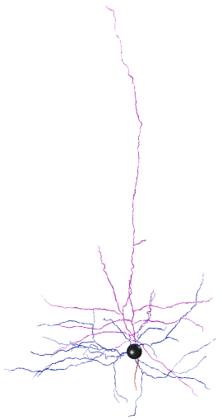
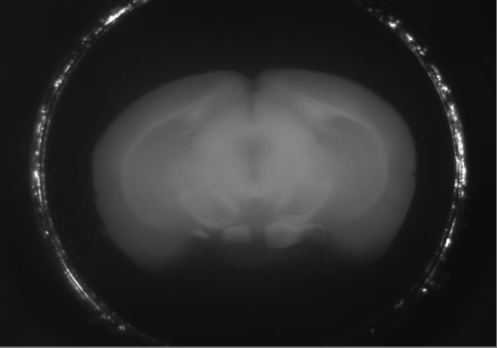
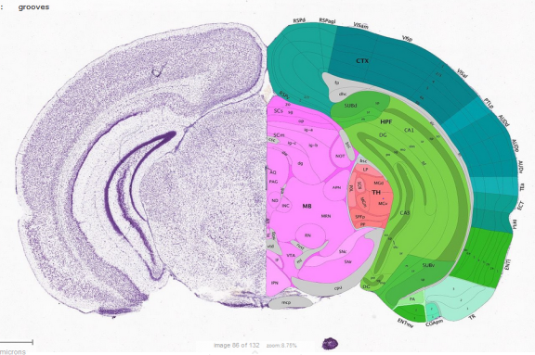
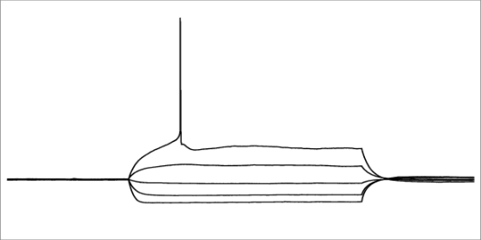
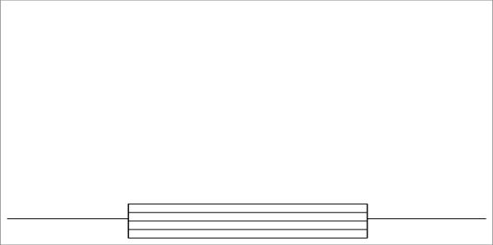
Databases
Allen Cell Types Database (and SDK)
https://celltypes.brain-map.org
electrophysiological, morphological and transcriptomic data from mouse and human cortex and thalamus
Allen Software Development Kit (SDK) to analyse raw data and run models
Mouse Metadata
Electrophysiology
Cell Imaging, Reconstruction
Genotype | Nr5a1:Ai14
Sex | M
Age | P56
100 µm
20 µm
Neuron Registration
Recording location and Cre label
are verified by images
X
30 mV
-76 mV
150 ms
30 µm
Cell location is marked on the
block face images to register to the Allen Reference Atlas
-90 → +70 pA
63X image stack acquired for every well-filled neuron. Reconstructions prioritized based on Ephys and fill.
Raw and summary Ephys data for
sub and suprathreshold activity

Slide 28
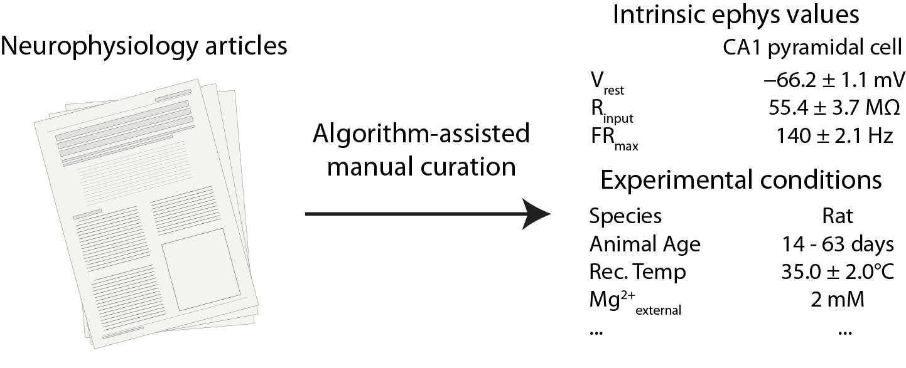
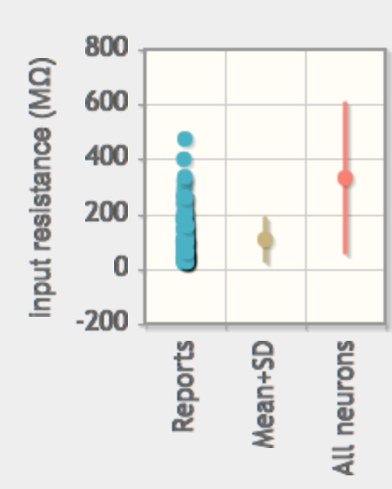
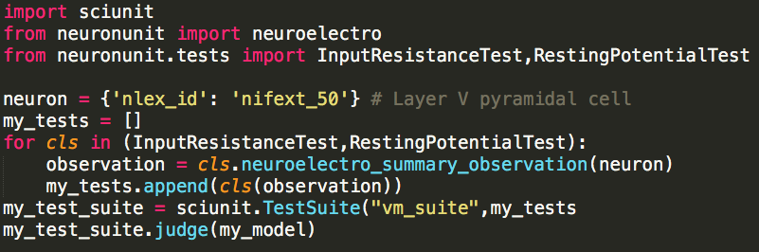

Databases
NeuroElectro
http://neuroelectro.org
Information about electrophysiological properties of neurons from the
literature
Data driven tests for model development and validation with NeuronUnit

Slide 29
Databases
Other databases
Allen Brain Observatory: in vivo activity in mouse visual cortex
http://observatory.brain-map.org/visualcoding
CRCNS.org: neurophysiological and behavioural data from a variety of species
https://crcns.org
Hippocampome.org: 23,238 Pieces of Knowledge (PoK) and 30,035 Pieces of Evidence (PoE) about rodent hippocampal neurons
https://hippocampome.org
Ion Channel Genealogy: ion channel database with ~4000 NEURON models and interactive visualisations
https://icg.neurotheory.ox.ac.uk

Slide 30
Types of resources for neuronal modelling
Simulators
Conductance-based multi-compartmental models
Abstract neuronal models, large scale simulations
Reaction-diffusion modelling, simulations of intracellular processes
General purpose software, custom-built simulations
Databases
Tools for the generation and analysis of neuronal morphologies
Interoperability frameworks
Other sources of information

Slide 31
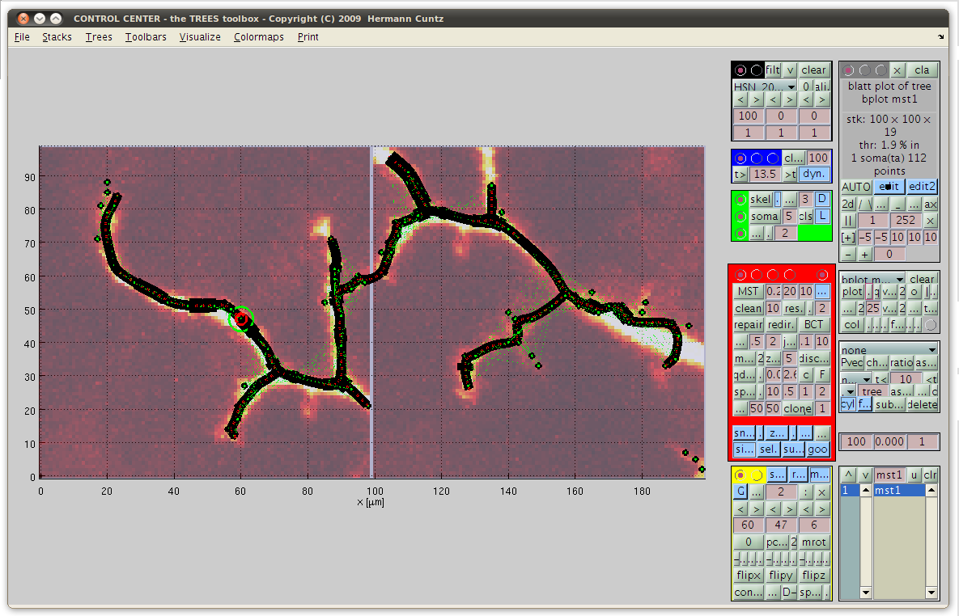
Generation and analysis of neuronal morphologies
TREES toolbox
https://www.treestoolbox.org
Software for the semi-automatic reconstruction, analysis and visualisation
of neuronal morphologies from image stacks
Can generate new synthetic neuronal trees based on existing ones
Freely distributed MATLAB code

Slide 32
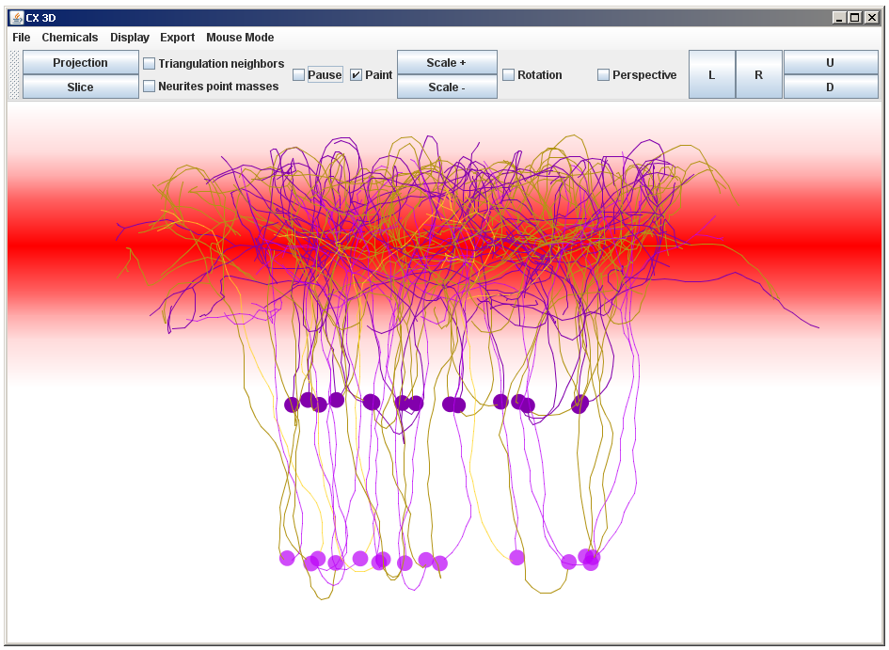
Generation and analysis of neuronal morphologies
CX3D
https://www.ini.uzh.ch/~amw/seco/cx3d
Tool for simulating the growth of cortex in 3D
Simulates division and migration of cells and growth of axonal and
dendritic trees along chemical gradients
New: parallel version CX3Dp

Slide 33
Generation and analysis of neuronal morphologies
NeuroDevSim
https://cns-oist.github.io/NeuroDevSim/index.html
Growth of 3D neuronal morphologies: neurons grow starting from a soma that can sprout dendrites and axons. Growth is embodied in fronts which mimic the functionality of growth cones: they can elongate, branch or terminate.
Cell migration: somata can migrate before sprouting dendrites. They can make a trailing axon during this migration.
Microcircuits: neurons are generated together in a simulated volume. With the addition of connections rules and synapses circuits emerge.
Interactions: growth can be influenced by environmental cues. Most obvious is guidance through repulsion or attraction by other neurons or chemical cues. Existing structures can block growth: physical overlap between structures is not allowed.

Slide 34
Types of resources for neuronal modelling
Simulators
Conductance-based multi-compartmental models
Abstract neuronal models, large scale simulations
Reaction-diffusion modelling, simulations of intracellular processes
General purpose software, custom-built simulations
Databases
Tools for the generation and analysis of neuronal morphologies
Interoperability frameworks
Other sources of information

Slide 35
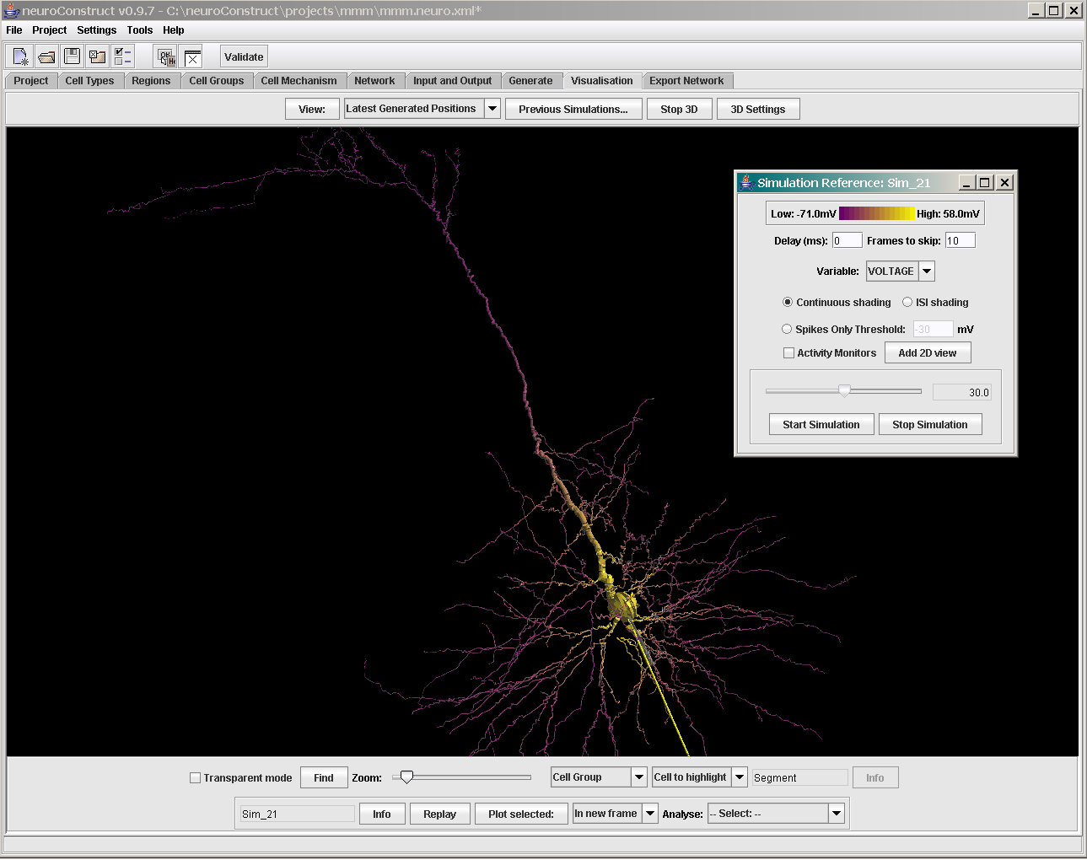
Interoperability frameworks
neuroConstruct
https://www.neuroConstruct.org
Software for the development, visualisation and analysis of biologically
detailed neuronal networks in 3D space
Automatic generation of scripts for NEURON, GENESIS, MOOSE, PSICS, PyNN

Slide 36
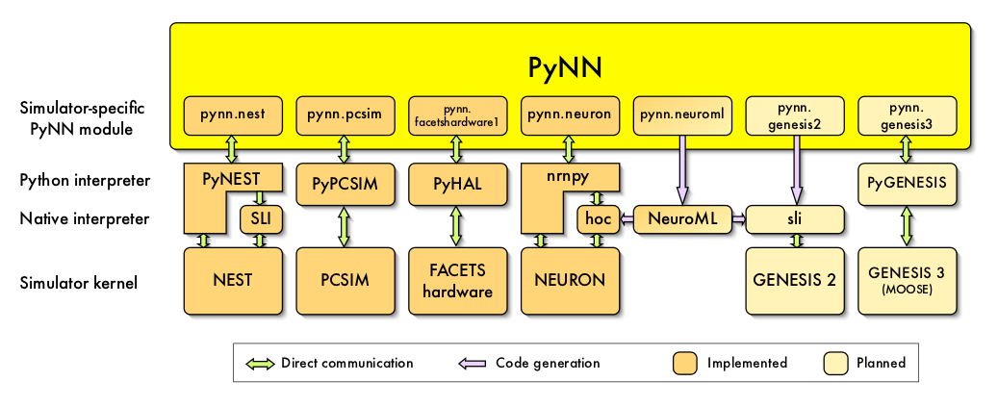
Interoperability frameworks
PyNN
https://neuralensemble.org/PyNN/
Python API for creating neural network simulations
Write script once then use on multiple simulators
(NEURON, NEST, Brian, Spinnaker, BrainScaleS neuromorphic hardware)
Mainly focussed on large scale networks of simple neuron models
Used by the Human Brain Project for neuromorphic computing

Slide 37
Interoperability frameworks
NeuroML
https://www.neuroml.org
XML based simulator-independent model description language
Aim is to facilitate the exchange of models between researchers
Description of models of neuronal systems at multiple scales
Development of NeuroML 2.0 is well under way (based on Low Entropy
Model Specification LEMS) but NeuroML 1.8 still more widely supported

Slide 38
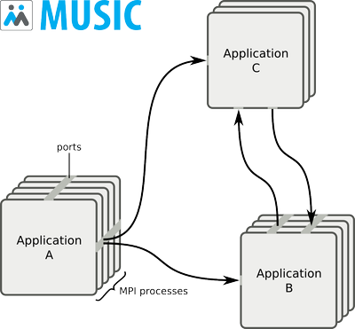
Interoperability frameworks
MUSIC
https://software.incf.org/software/music
C++ library implementing an API that allows neuronal network
simulators to exchange data during runtime
Can for example be used to run part of a simulation in NEST and
part in MOOSE

Slide 39
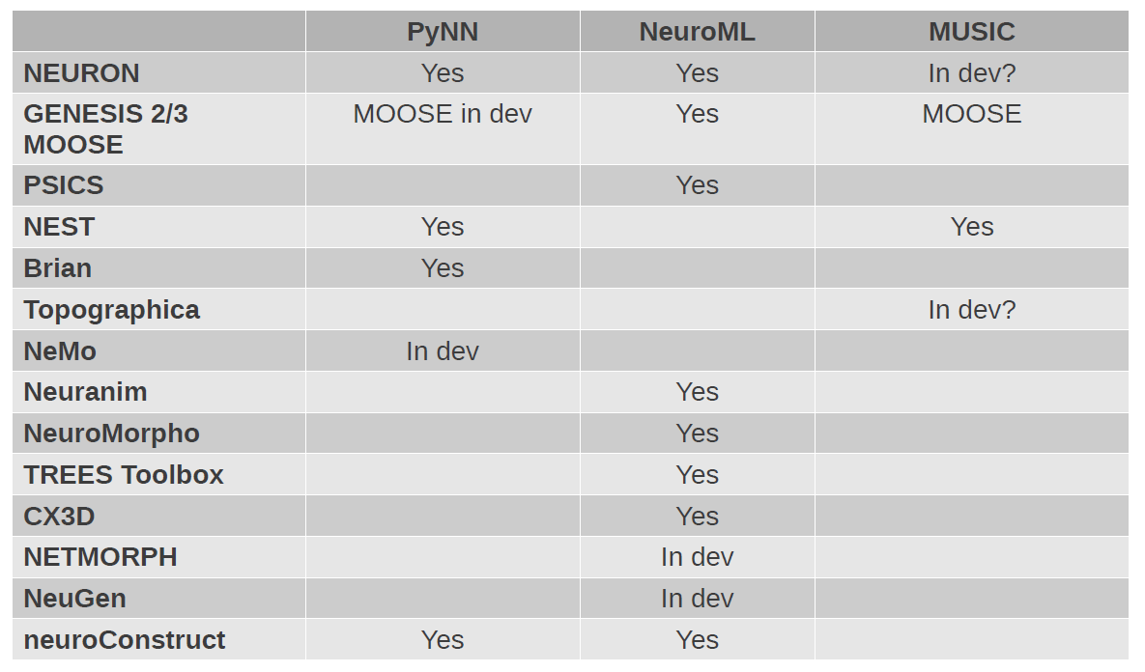
Support for interoperability

Slide 40
Types of resources for neuronal modelling
Simulators
Conductance-based multi-compartmental models
Abstract neuronal models, large scale simulations
Reaction-diffusion modelling, simulations of intracellular processes
General purpose software, custom-built simulations
Databases
Tools for the generation and analysis of neuronal morphologies
Interoperability frameworks
Other sources of information

Slide 41
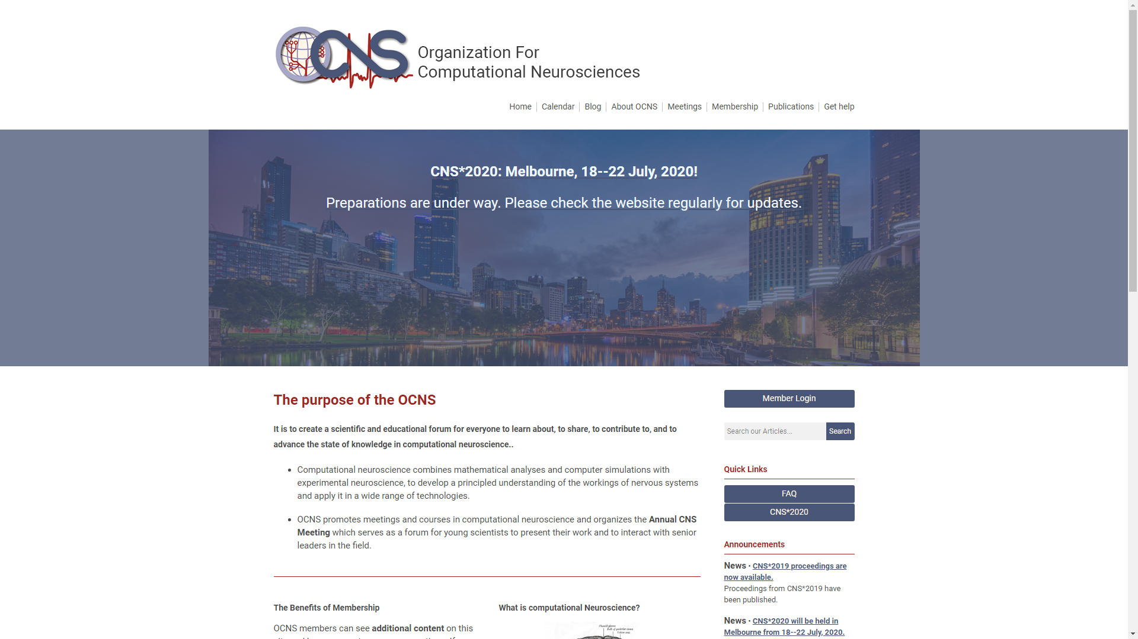
Other information sources
Organization for Computational Neurosciences (OCNS)
https://www.cnsorg.org

Slide 42

Other information sources
INCF
https://www.incf.org/

Slide 43
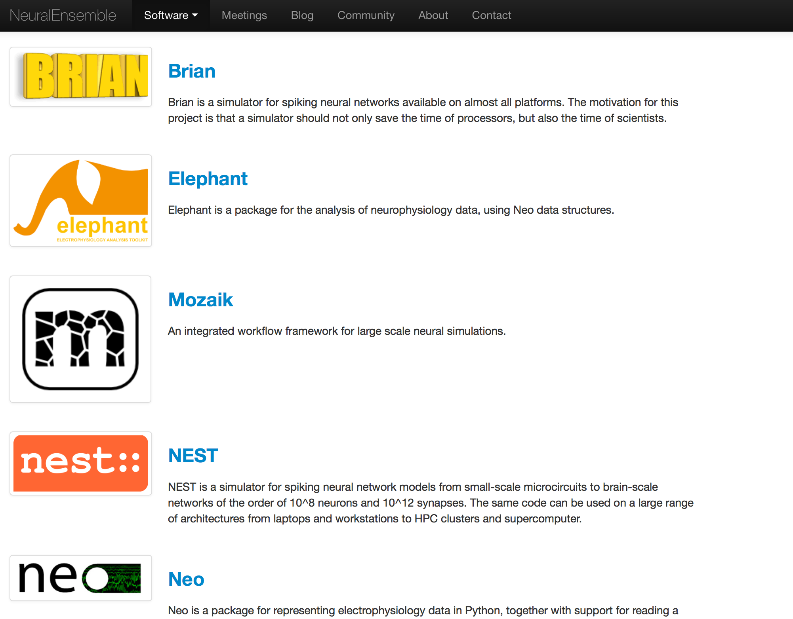
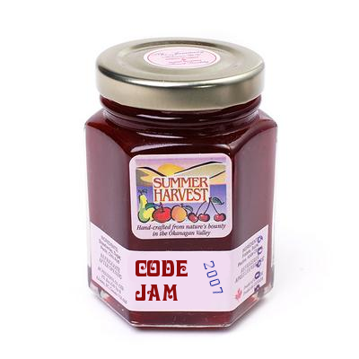
Other information sources
NeuralEnsemble
https://neuralensemble.org
Community based initiative for open-source software development in computational neuroscience, organises Code Jam workshops

Slide 44

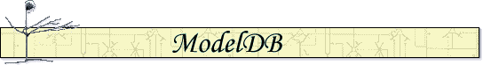


Other information sources
Neuroscience Gateway (NSG)
http://www.nsgportal.org
Freely available high performance computing resource
NSG user interface
Browser interface
HPC resource 1
Programmatic access
NSG
HPC resource 2
Other Neuroscience community projects
RESTful web services
HPC resource3

Slide 45
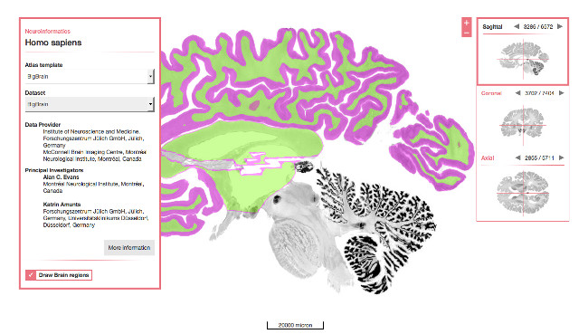
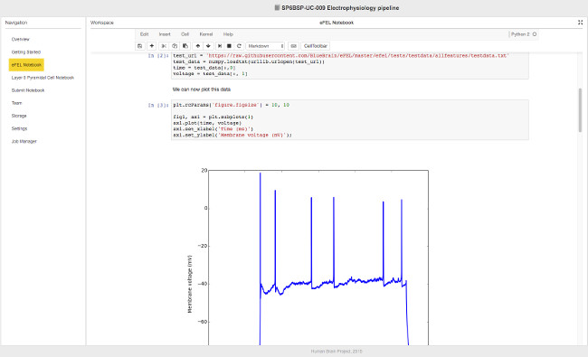
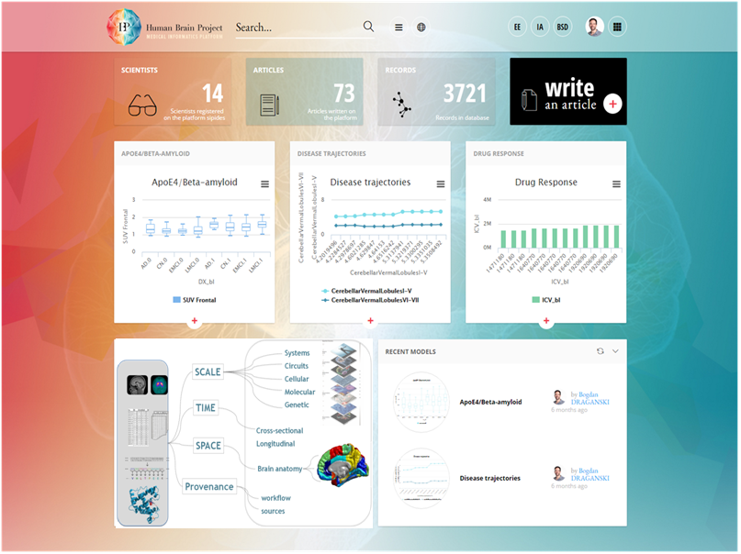
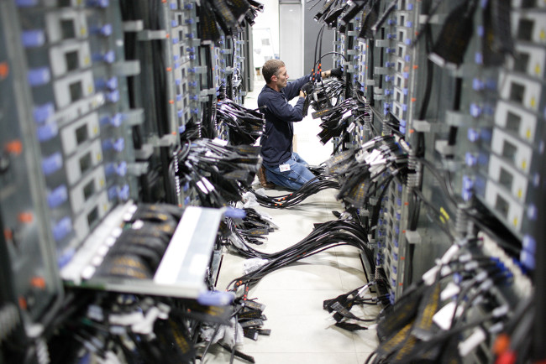


Other information sources
EBRAINS
https://ebrains.eu
Open Research Infrastructure, tools from the Human Brain Project platforms
Neuroinformatics
Brain Simulation
Medical Informatics
High Performance Analytics and Computing (HPAC)
Neuromorphic Computing
Neurorobotics

Slide 46

Open Source Brain Initiative
Other information sources
Open Source Brain
https://www.opensourcebrain.org/
Olfactory Bulb
Migliore et al (2014)
Olf. Bulb network model
Neocortex
Mainen et al. (1995)
L5 Pyramidal cell
Rothman et al. (2010)
L5 Pyramidal cell
Hay et al (2011)
L5 Pyramidal cell
Traub et al. (2005)
L2/3 Pyr (FRB/RS), L4SS,
L5 Pyr (IB/RS), L6 Pyr,
Deep & superficial basket,
axo-axonic & LTS interneurons,
Cortical column network
model
Cerebellum
Maex and Schutter (1998)
Granule cell layer
Steuber and Saviane, based
on Berends et al. (2005)
Granule cell
Vervaeke et al. (2010)
Golgi cell network
Solinas et al. (2007a,b)
Granule cell, Golgi cell
De Schutter and Bower (1994)
Purkinje cell
Steuber et al. (2011)
Cerebellar nucleus neuron
Abstract neuron models
Izhikevich (2003)
Morris & Lecar (1981)
FitzHugh & Nagumo (1969)
Hippocampus
Migliore et al. (2005)
CA1 Pyramidal cell
Bezaire et al (2017)
Full scale CA1
Thalamus
Traub et al. (2005)
Thalamocortical relay cell,
Nucleus reticularis thalami cell
C elegans
OpenWorm project
302 cell connectome

Slide 47
Other information sources
ReScience
https://rescience.github.io
Journal Philosophy
ReScience is a peer-reviewed journal that targets computational research and encourages the explicit replication of already published research, promoting new and open-source implementations in order to ensure that the original research is reproducible.
To achieve this goal, the whole publishing chain is radically different from other traditional scientific journals. ReScience lives on GitHub where each new implementation of a computational study is made available together with comments, explanations and tests. Each submission takes the form of a pull request that is publicly reviewed and tested in order to guarantee that any researcher can re-use it.
Publishing fees
None.

Slide 48
Other information sources
Mailing lists
connectionists
https://mailman.srv.cs.cmu.edu/mailman/listinfo/connectionists
comp-neuro
https://lists.cnsorg.org/hyperkitty/list/comp-neuro@lists.cnsorg.org/

